Slide 1
Atopic dermatitis
Shulamit Burstein

Slide 2
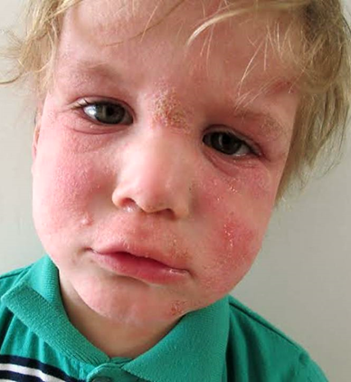
Did you know?
 Eczema mortality:
8-year reduction in lifespan
 Economic impact :
The annual economic burden is estimated at $5.3 billion
 Eczema comorbidities:
50% of children with severe AD develop asthma
75% develop allergic rhinitis
 Children and adolescents have higher rates of depression, anxiety and conduct disorder and more likely to be diagnosed with ADHD
 Children with AD have an increased risk of presenting with Autism Spectrum Disorder

Slide 3
Description:
An inflammation of the skin (dermatitis)
Pruritus - Itchy,
Erythema - Redness
Xerosis – Dryness
Lichenification – Thickness
Edema - Swolleing
Oozing and crusting
Scratch marks

Slide 4
 Diagnosis
Hanifin and Rajka Criteria for Atopic Dermatitis
Pruritus Dermatitis affecting flexural surfaces in adults or face and extensor surfaces in infants Chronic or relapsing dermatitis Personal or family history | Major criteria (must have 3)
Facial features Triggers Complications Other | Minor criteria (must have 3)
Jon M. Hanifin and Georg Rajka Acta Dermatovener (Stokholm) Suppl. 92: 44-47 1980

Slide 5
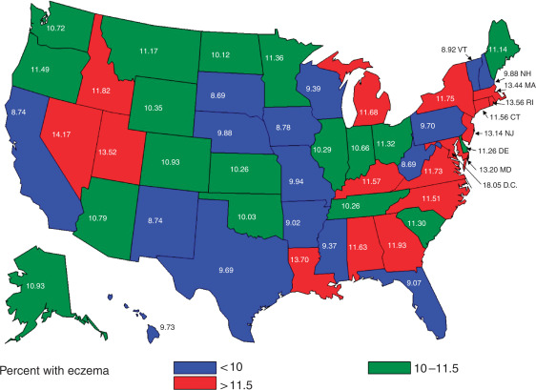
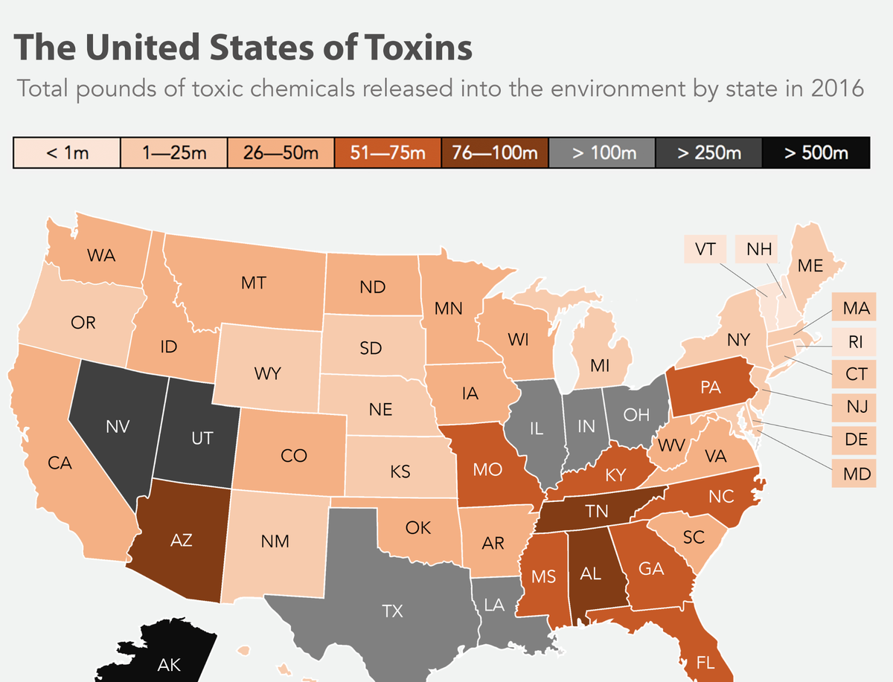
 Prevalence
Journal of Investigative Dermatolog Volume 131, Issue 1, January 2011, Pages 67-73
18 million adults (7.2%) have atopic dermatitis.
9.6 million (13%) children under the age of 18 have atopic dermatitis
(national eczema association).

Slide 6
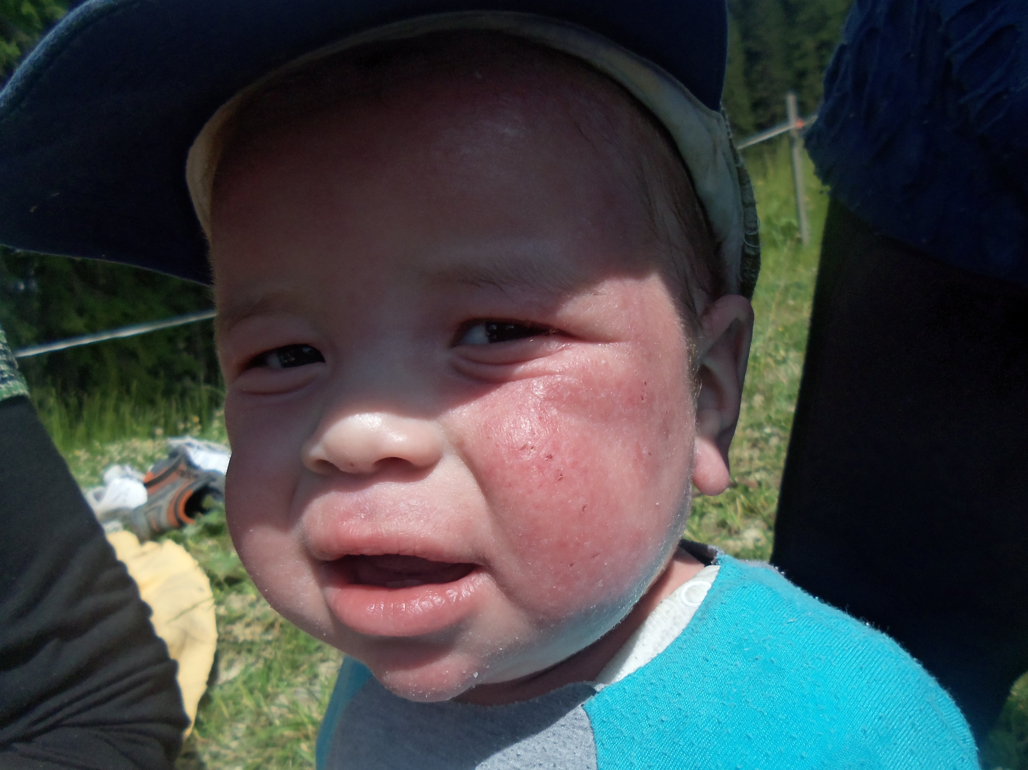
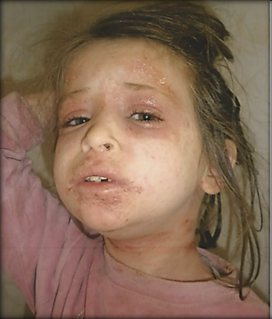
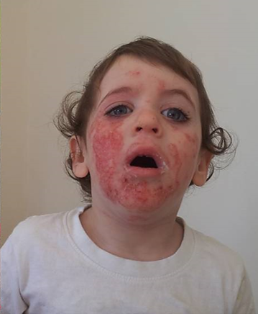
 The suffering

Slide 7
 Defect skin barrier
Atopic dry skin Healthy skin

Slide 8
 Multi disciplinary understanding
The skin – the barrier defect
The inflammation & infections
The Environment
Allergies and Triggers
Emotions and stressors

Slide 9
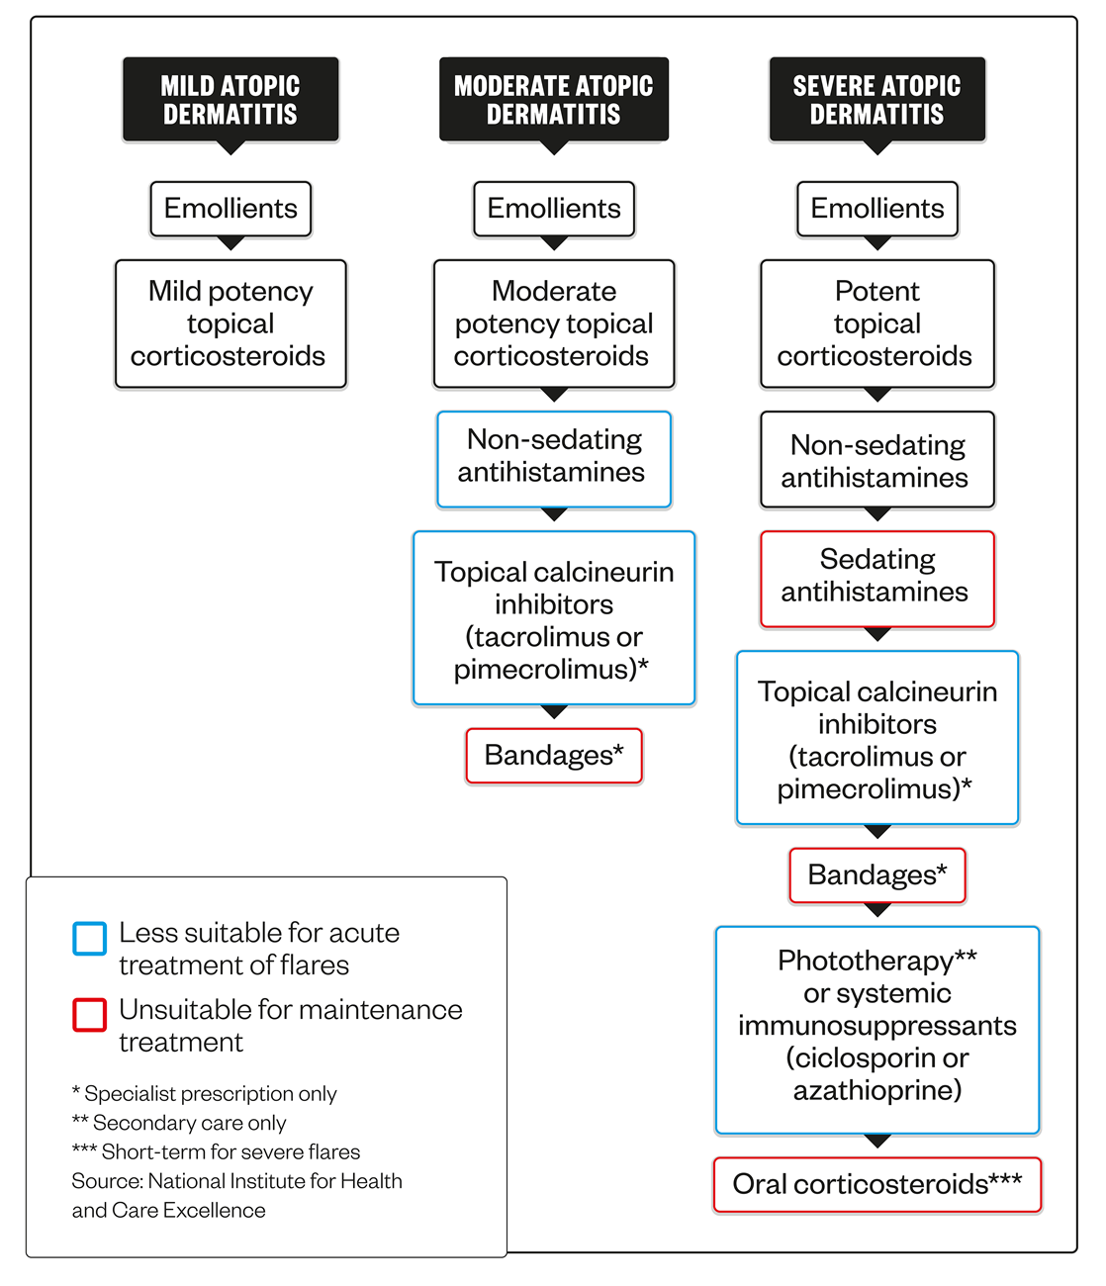
available Treatments
Atopic dermatitis: emerging and current treatments
The Pharmaceutical Journal23 FEB 2017By Dawn Connelly
Dupixent – biological injection

Slide 10
Lack of awareness
Miss- Information
Lack of Education
Lack of empathy
the missing link in the system

Slide 11
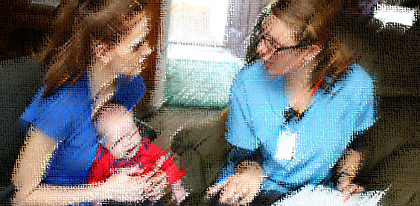
The role and impact of a nurse
Source of support
Educating
First line of information

Slide 12
CONCLUSIONS:
The most effective way to manage atopic eczema is to provide adequate time for education and demonstration of treatments, which the literature suggests can be achieved through nurse-led clinics. The literature review supports an investigation researching the outcomes of a nurse-led clinic on reducing the severity of eczema in children.
Br J Dermatol. 2006 Dec;155(6):1242-8.
Nurse-led clinics reduce severity of childhood atopic eczema: a review of the literature.
Moore E¹, Williams A, Manias E, Varigos G.

Slide 13
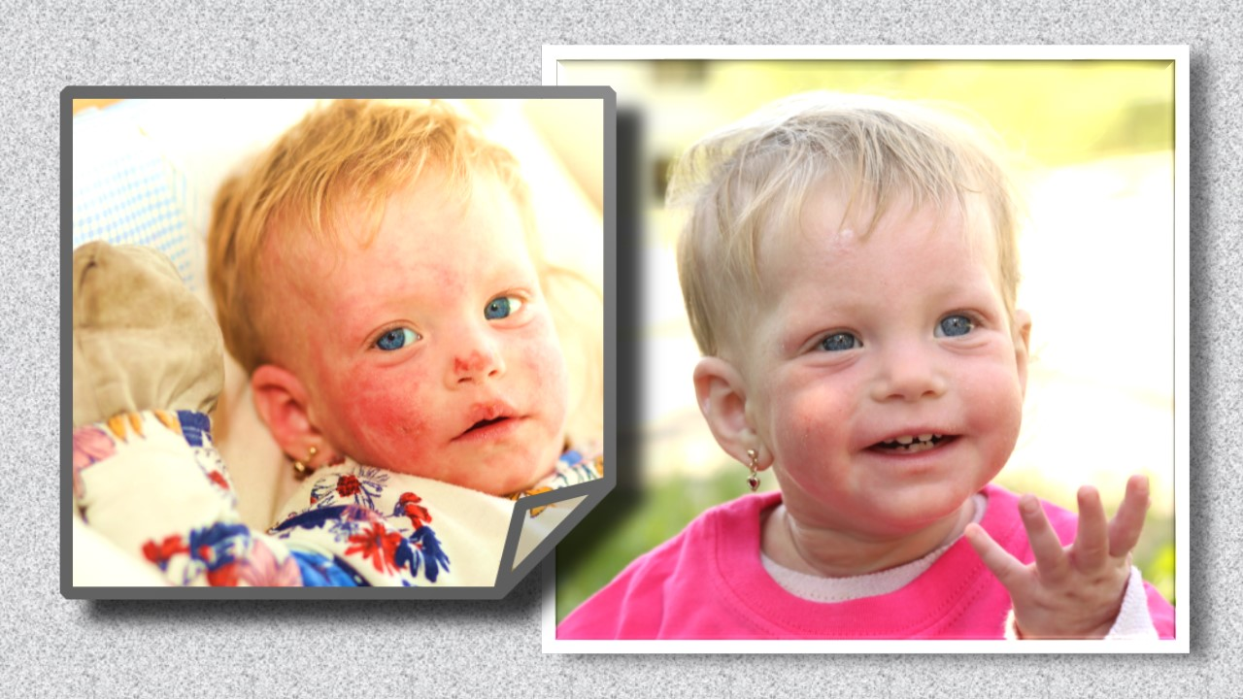
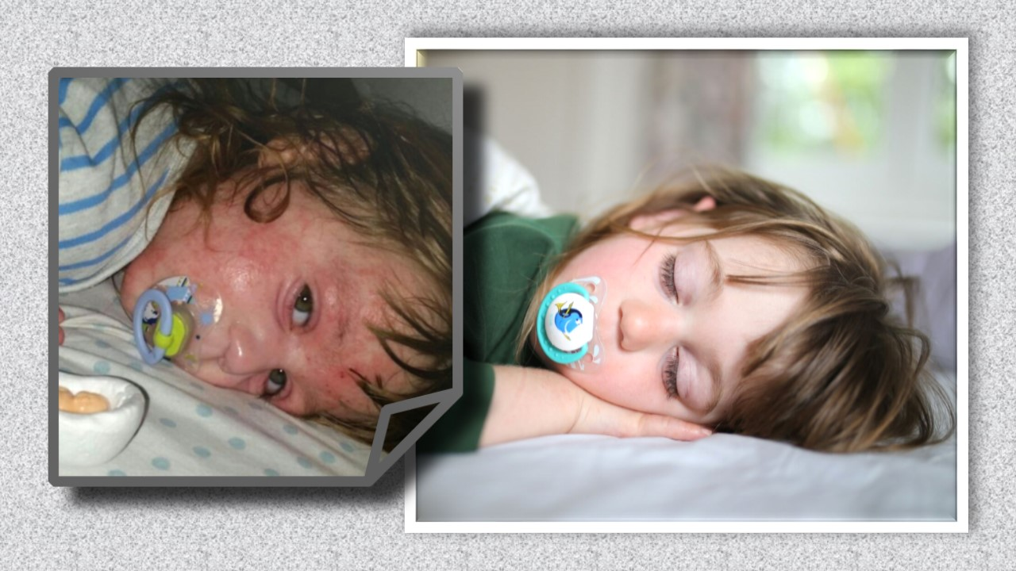
Thank you!

