Slide 1
Sexual Health Assessment:
Discussing The Uncomfortable
Esther Lebovic DNP, FNP-BC, CSC

Slide 2
Importance Of Sexual Health Assessment In Primary Care
Integral to holistic care- decreases patient risk for sexual dysfunction, STDs, pregnancy
Often excluded- provider & perceived patient discomfort, lack of clinical training, time, shame
Prevention:
  Primary- preventative, education
  Secondary- screening
  Tertiary- early diagnosis, treatment

Slide 3

Sexual Dysfunction And Treatment
Diagnosis: patient experience
Four Categories- Female and Male
Desire Disorders
Arousal Disorders
Orgasmic Disorders
Pain Disorders
PSDGraphics

Slide 4
Assessment of Sexual Dysfunction
Physiology/ Structure
Musculoskeletal
Infection
Hormones
Psychology/ Emotion
Medical/ Surgical History
Education
Life Stage
Special Circumstances: pregnancy, postpartum
Medications
Partner
Abuse- history, current

Slide 5
Assessment of Sexual Dysfunction
Physiology and Musculoskeletal:
  Dyspareunia- pain before, during or after, deep or superficial
  Vaginismus- involuntary contraction of pelvic floor muscles
  Vulvodynia- chronic pain in vulva, general or local, primary or secondary, genetic, sensitivity, irritation, medication, neuropathic
  Vestibulodynea- pain between labia minora, nerve sensitivity, provoked: hormonal, neuroproliferative,
  Hymen Irregularities- septate, imperforate, microperforate
  Endometriosis, uterine fibroids, ovarian cysts

Slide 6
Assessment of Sexual Dysfunction
Physiology
  Erectile dysfunction
  Premature ejaculation
  Delayed or inhibited ejaculation

Slide 7
Assessment of Sexual Dysfunction
Infection:
  Bacterial Vaginitis
  Candida Vulvovaginitis
  STD
  UTI
  Dermatology- lichen sclerosis, lichen planus, dermatitis, eczema, psoriasis

Slide 8
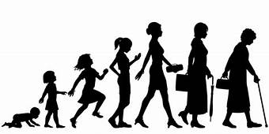
Assessment of Sexual Dysfunction
Hormones, Psychology, Emotion, Education, and Medication:
  Low desire, poor arousal, anorgasmia
  Erectile dysfunction, Premature ejaculation
Life Stage, Special Circumstances:
  Pregnancy, postpartum
  Hormonal contraception
  Menopause
  Illness
www.Wisdompills.com

Slide 9
Treatment Of Sexual Dysfunction
Education/ Counseling/ Therapy
  Mindfulness, sensate focus, literature, lubricants, aids, scheduling, communication
Medication
  Anesthetics, osphena, hormones, SSRI’s (bupropion/ Wellbutrin, Zoloft), anxiolytics (buspirone/ BuSpar), filbanserin (Addyi), Valium suppositories
Dilation
Physical Therapy
Laser, Botox
Surgery

Slide 10

Sexual Health Assessment Tools
Cultural Competence
Non Judgmental
Safe Space
Time

Slide 11
Sexual Health Assessment Tools
Path to Intimacy, Connection, Sexual Satisfaction & Love (PICSSL) Model (Ryan, M.A. 2015)
Tools:
  PLISSIT (Annon, J. S., 1976)
  A Guide to Taking a Sexual History (CDC, 2005)
    5 P’s: Partners • Practices • Protection from stds • Past history of stds • Prevention of pregnancy
  One Key Question (Oregon Foundation for Reproductive Health, 2012)
  Assessing Sexual Health in the Orthodox Jewish Patient (Lebovic, E., 2016)

Slide 12
PICSSL Model
Ryan, M.A. 2015

Slide 13
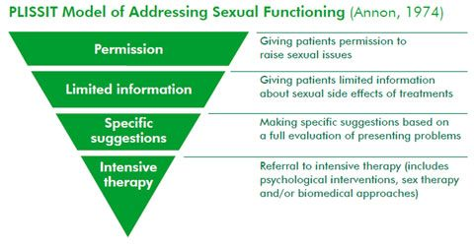
One Key Question:
“Would you like to become pregnant in the next year?” and have four response options of Yes, No, Unsure, and OK Either Way. (Oregon Foundation for Reproductive Health, 2012)

Slide 14

Significance Of Sexual Health Assessment In Orthodox Jewish Population
Increased risk
Limited sexuality education
Separation of sexes
Modesty
Taharat Hamishpacha
Importance of cultural competence
Role of Rabbi

Slide 15
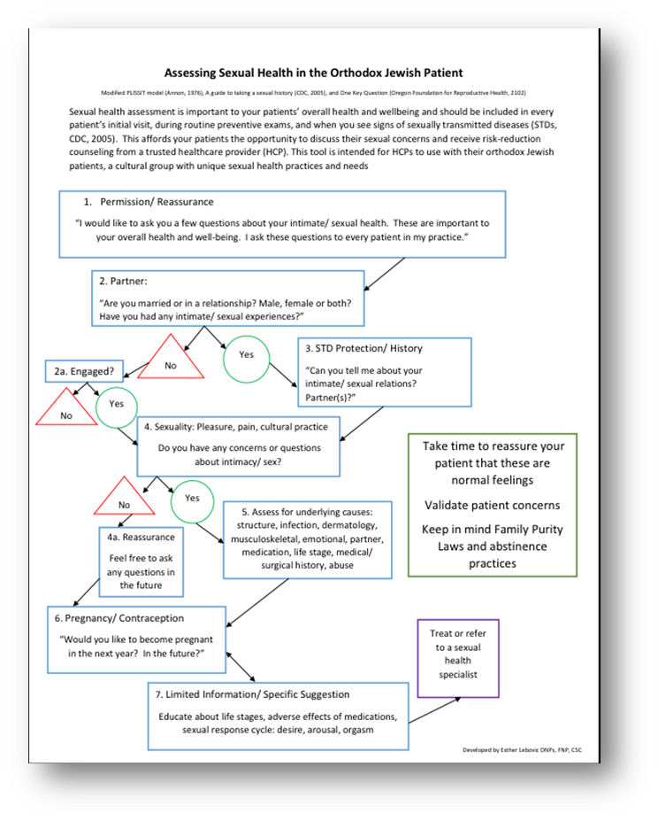

Slide 16
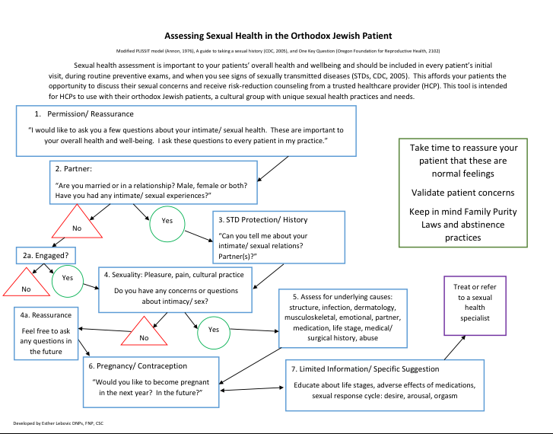

Slide 17

Primary Prevention
Premarital Education
Healthcare Provider Assessment:
  Establishing patient/ provider relationship
  Primary care/ women’s health/ sexual health
  Contraception/ bleeding control
  Evaluation, treatment
  Preconception screening, pregnancy workup
www.jordanjewellery.com

Slide 18
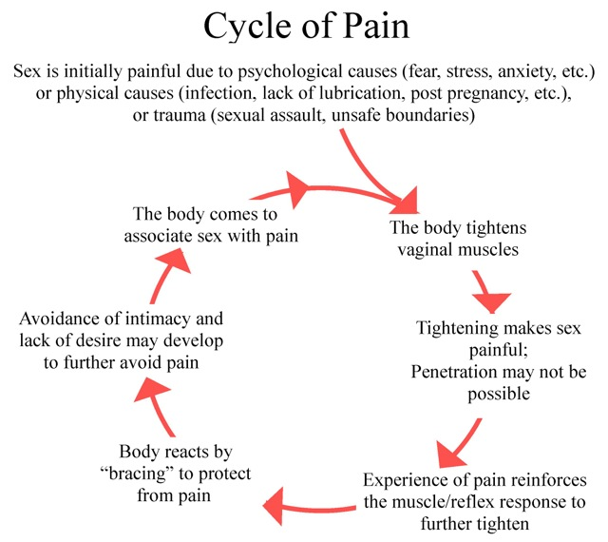
CreatingChangeLA.com, 2018

Slide 19
Secondary and Tertiary Prevention
Assessment Tools
Appropriate Referrals and Follow up
  OB/GYN, PCP
  Urology, Uro/gynecology
  Sex counselor, sex therapist
  Physical therapist- pelvic floor rehabilitation
  Sexual medicine

Slide 20
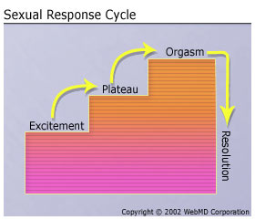
Sexual Response Cycle

Slide 21
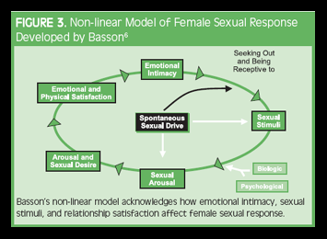
Female Sexual Response Cycle
Association of Reproductive Health Professionals, 2008

Slide 22
Cultural Competence
Increases assessment, increases patient compliance
Educating colleagues about Orthodox Judaism
  Taharat Hamishpacha
    Timeliness, stress, fertility
  Cultural values:
    Modesty
    Separation of sexes
    Marriage at young age

Slide 23
Conclusion
Importance of sexual health assessment
Lack of assessment leaves patients at risk
Orthodox Jewish patients at increased risk
Cultural competence
Discussion, assessment, diagnosis, treatment or referral
Improved sexual health in community

Slide 24
Recommended Reading
A Guide to the Orthodox Jewish Way of Life for Healthcare Professionals (Spitzer, J., 2005)
Marital Intimacy: A Traditional Jewish Approach (Friedman, A. P., 2005)
The Newlywed’s Guide to Physical Intimacy Et Le’ehov (Rosenfeld, J, Ribner, D.S., 2011)
Talking about Intimacy & Sexuality: A Guide for Orthodox Jewish Parents (Debow, Y., 2012)
The PICSSL Model: A New Strategy For Addressing Patients’ Intimacy And Sexuality Concerns (Ryan, M.A., 2015) https://npwomenshealthcare.com/the-picssl-model-a-new-strategy-vol3-no2/
A Guide to Taking a Sexual History (CDC, 2005)
PLISSIT Model

Slide 25
References
Annon, J. S. (1976). The plissit model: A proposed conceptual scheme for the behavioral treatment of sexual problems. Journal of Sex Education and Therapy, 2(1), 1-15. http://dx.doi.org/DOI:10.1080/01614576.1976.11074483
Briedite, I., Ancane, G., Ancans, A., & Erts, R. (2013). Insufficient assessment of sexual dysfunction: A problem in gynecological practice. Medicina (Kaunas) 49 (7): 315-320. Retrieved from: https://www.researchgate.net/publication/259490872_Insufficient_Assessment_of_Sexual_Dysfunction_A_Problem_in_Gynecological_Practice/fulltex t/5addd2dbaca272fdaf870dca/259490872_Insufficient_Assessment_of_Sexual_Dysfunction_A_Problem_in_Gynecological_Practice.pdf
Centers for Disease Control and Prevention (2005). A guide to taking a sexual history. Retrieved from http://www.cdc.gov/STD/treatment/SexualHistory.pdf
Grajower, M. M., Willig, M., & Grazi, R. (2009). The Jewish bride: Getting her to her wedding night ritually clean using norethindrone acetate (aygestin). Retrieved from Yeshiva University Torah Online: download.yutorah.org/2009/1053/733773.pdf
Hall, K. S., & Graham, C. A. (2014). Culturally sensitive therapy: The need for shared meanings in the treatment of sexual problems. In J. L. Wetchler, Y. M. Binik, & K. S. Hall (Eds.), Principles and Practices of Sex Therapy (5th ed., pp. 334-358). Retrieved from http://eprints.soton.ac.uk/364225/
Itkin, N. (2014). Treating Sexual Dysfunction In Orthodox Jewish Couples (Doctoral Dissertation, Alliant International University). Retrieved from http://media.proquest.com/media/pq/classic/doc/3403913981/fmt/ai/rep/NPDF?_S=tqnc%2bfyfogjzlefuu0eftixmykk%3d
Kingsberg, S. A. (2006). Taking a sexual history. Obstetrics and Gynecology Clinics of North America, 33, 535-547. http://dx.doi.org/10.1016/j.ogc.2006.09.002
Landa, J., Faubion, S. S., Rullo, J., Simon, J. A., Yarnell, E., Khanba, B., ... Kandhan, L. (2016). Clinical roundup: Selected treatment options for sexual dysfunction. Alternative and Complementary Therapies, 22(1), 37-42. http://dx.doi.org/10.1089/act.2016.29042.cru
Ryan, M.A. (2015). The PICSSL model: A new strategy for addressing patients ’ intimacy and sexuality concerns. Women’s Healthcare: A Clinical Journal for NPs. 3 (2) 20-26. Retrieved from: https://npwomenshealthcare.com/the-picssl-model-a-new-strategy-vol3-no2/

Slide 26

Esther Lebovic DNP, FNP-BC, CSC
elebovic@icloud.com

