Slide 1
Addiction: An Ounce of Prevention is Worth a Pound of Intervention
Ian (Ephraim) Sherman, DNP, RN, AGPCNP-BC

Slide 2
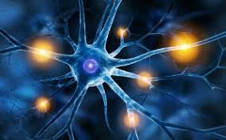
What is pain?
…Well, what is it?

Slide 3
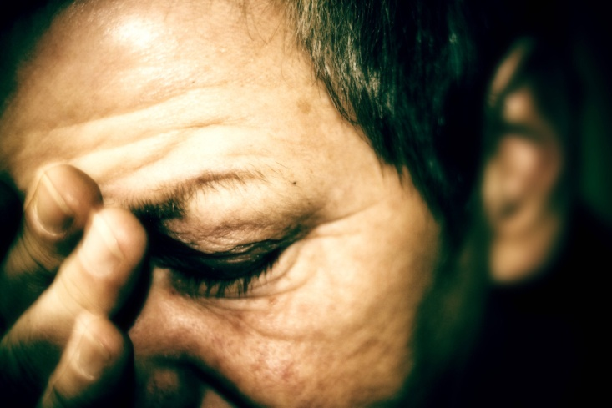
Defining Pain
The International Association for the Study of Pain defines it as "an unpleasant sensory and emotional experience associated with actual or potential tissue damage, or described in terms of such damage“
It is categorized as either nociceptic or neuropathic.

Slide 4
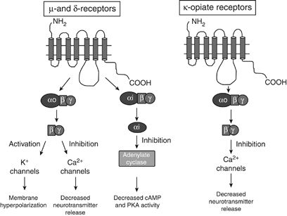
Defining Pain
Neuropathic
Central
Sympathetic
Cellular
Nociceptic
Peripheral
Visceral
A signal within the nervous system that there may be a problem.

Slide 5
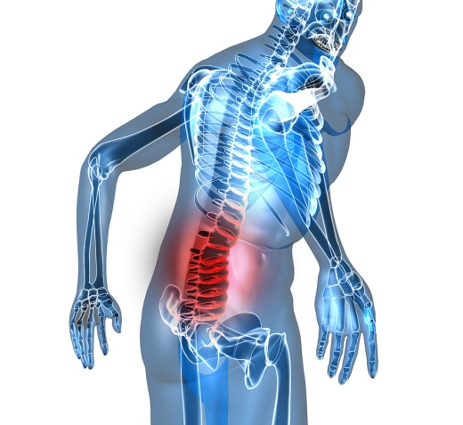
Chronic Pain Conditions
Lumbar Radiculopathy and Low Back Pain
The number one cause of disability in the US.
Among the most commonly treated complaints in ER.
Responsible for $100 billion in healthcare expenditure annually.
(Manchikanti, Knezevic, Boswell, Kaye, & Hirsch, 2016)

Slide 6
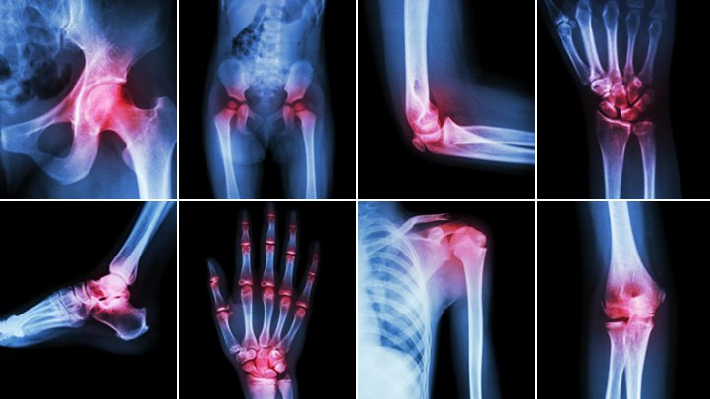
Chronic Pain Conditions
Arthritis of the Knees
Arthritis of the Shoulders
“Frozen Shoulder”

Slide 7
Chronic Pain Treatment
“Pain is a vital sign”
“Pain is subjective”
“Pain is as bad as the patient says it is”

Slide 8
Opioid Medications
How on earth can you NOT prescribe that person an opioid???
What else are we supposed to do???

Slide 9
Chronic Pain
Pain and suffering are often treated as synonymous. THEY ARE NOT.

Slide 10
Safe Chronic Pain Treatment
Physical therapy
Gabapentin, aiming for a daily dose of 1,200mg or higher.
Lyrica, when insurance will approve it.
Muscle relaxers, such as cyclobenzaprine and baclofen.
NSAIDs, especially meloxicam and diclofenac.
Topical gels and creams.
Good old fashioned acetaminophen.
SNRIs and TCAs (duloxetine and nortriptyline)
But the most effective treatments overall?

Slide 11
Yoga and Mindfulness
“There is strong evidence for short-term effectiveness and moderate-quality evidence for long-term effectiveness of yoga in the treatment of chronic low back pain (Will, Bury, & Miller, 2018).”

Slide 12
Opioids
Cancer, even in recovery phase if radiation and/or chemotherapy have caused neuropathy.
Post-Laminectomy Syndrome
Neuropathy related to HIV
Chronic Regional Pain Syndrome
Phantom limb pain
Post thoracotomy pain
Rheumatoid arthritis, if other treatments have failed

Slide 13
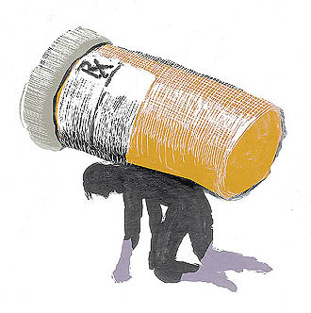
Opioid Use Disorder
It’s a spectrum, with differing levels of severity.
Exact criteria for diagnosis vary (DSM 5 vs ASAM and others), but the essential features are the same.
Addiction vs physical dependence.

Slide 14
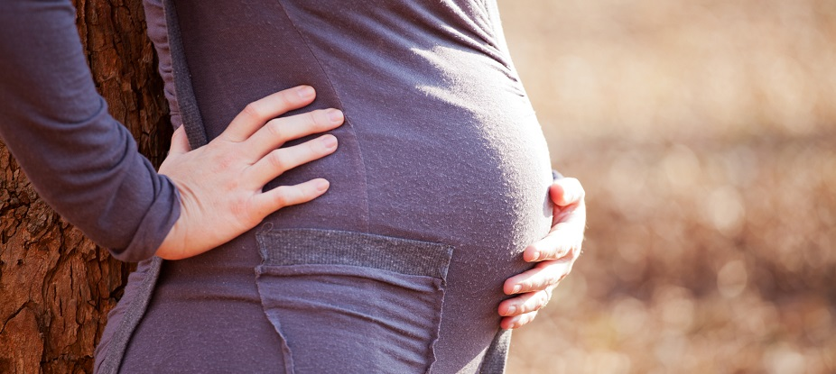
Opioids in Pregnancy
This is a topic that both healthcare providers and child safety workers are often significantly misinformed about!!!

Slide 15
Opioids in Pregnancy
Intrauterine fetal withdrawal is VASTLY more dangerous than NAS
The American College of Obstetricians and Gynecologists endore opioid agonist therapy for women with opioid use disorders (Carlson, 2018).

Slide 16
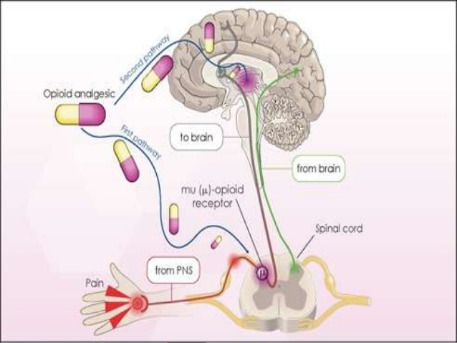
Agonist and Antagonist Therapy
Opioid Agonists
Methadone
Buprenorphine
Opioid Antagonists
Naloxone
Naltrexone

Slide 17
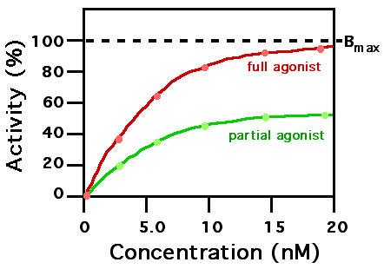
Buprenorphine/Naloxone
Buprenorphine as partial agonist.
Presence of naloxone in oral and buccal formulations.

Slide 18
Buprenorphine/Naloxone
Co-administration of benzodiazepines.
Pushback from Narcotics Anonymous and others.
This something that NPs can be on the cutting edge of in terms of positive change.

Slide 19
References
Budenholzer, B. (2018). Nonopioids and opioids gave similar relief for back pain or osteoarthritis but nonopioids had fewer adverse effects. Annals of Internal Medicine, 168(12), JC64. https://doi-org.proxy.wexler.hunter.cuny.edu/10.7326/ACPJC-2018-168-12-064
Carlson, N. S. (2018). Current Resources for Evidence‐Based Practice, September/October 2018. Journal of Midwifery & Women’s Health, 63(5), 616–622. https://doi-org.proxy.wexler.hunter.cuny.edu/10.1111/jmwh.12895
Foster, N. E., Anema, J. R., Cherkin, D., Chou, R., Cohen, S. P., Gross, D. P., … Maher, C. G. (2018). Prevention and treatment of low back pain: evidence, challenges, and promising directions. Lancet, 391 North American Edition(10137), 2368–2383. https://doi-org.proxy.wexler.hunter.cuny.edu/10.1016/S0140-6736(18)30489-6
Mohamadi, A., Chan, J. J., Lian, J., Wright, C. L., Marin, A. M., Rodriguez, E. K., … Nazarian, A. (2018). Risk Factors and Pooled Rate of Prolonged Opioid Use Following Trauma or Surgery: A Systematic Review and Meta-(Regression) Analysis. Journal of Bone & Joint Surgery, American Volume, 100(15), 1332–1340. https://doi-org.proxy.wexler.hunter.cuny.edu/10.2106/JBJS.17.01239
Monico, L. B., Gryczynski, J., Schwartz, R. P., Jaffe, J. H., O’Grady, K. E., & Mitchell, S. G. (2018). Treatment outcomes among a cohort of African American buprenorphine patients: Follow-up at 12 months. American Journal of Drug & Alcohol Abuse, 44(6), 604–610. https://doi-org.proxy.wexler.hunter.cuny.edu/10.1080/00952990.2018.1461877
https://s3.amazonaws.com/rdcms-iasp/files/production/public/Content/ContentFolders/Publications2/ClassificationofChronicPain/Introduction.pdf
Manchikanti, L., Knezevic, N. N., Boswell, M. V., Kaye, A. D., & Hirsch, J. A. (2016). Epidural Injections for Lumbar Radiculopathy and Spinal Stenosis: A Comparative Systematic Review and Meta-Analysis. Pain Physician, 19(3), E365–E410. Retrieved from http://proxy.wexler.hunter.cuny.edu/login?url=http://search.ebscohost.com/login.aspx?direct= true&db=ccm&AN=114263789&site=ehost-live
Will, J. S., Bury, D. C., & Miller, J. A. (2018). Mechanical Low Back Pain. American Family Physician, 98(7), 421–428. Retrieved from http://proxy.wexler.hunter.cuny.edu/login?url=http://search.ebscohost.com/login.aspx?direct=true& db=ccm&AN =131984939&site=ehost-live

