Slide 1
An Ounce of Prevention is Worth a Pound of Prevention
Prevention Strategies for Targeting
Nomedical Use and Abuse
of Prescription Medications
Perella Perlstein, PsyD
OJNA Conference
January 6, 2013

Slide 2
Objectives
Pathways of Nomedical Use and Abuse of Prescription Medications (NUAMP)
Introduce Prevention Models targeting NUAMP
Discuss Socio-ecological Model
Highlight Individual and Environmental Risk Factors

Slide 3
SARAH’S STRORY
Sarah was a 31 year-old, mother of 2, who struggled with depression, anxiety, and a poor sense of self-worth.
She initially sought and gained a prescription from her Primary Care Physician for something to help her sleep (Klonopin).
She tried psychotherapy three times, but dropped out prematurely (average of 3 visits) because she did not find it useful.
To ease her anxiety and depressive symptoms, she began self-medicating, and, after her PCP refused to refill her prescription, she began buying Oxycodone from her former boyfriend.
At some point, Sarah divorced her husband and resumed her relationship with her former boyfriend.
When she was no longer able to afford Oxycodone, she switched to something cheaper, Heroin.
Sarah’s sister brought her to the ER after Sarah expressed active Suicidal Ideation. In the ER, Sarah denied SI and was released 12 hours later. She was never admitted.
After the ER visit, Sarah attended an intake at a local private practice and was told that she needed to undergo Drug Detox and Rehabilitation before she can be accepted as a patient at the practice.
Sarah refused the recommendation.
She died of a Heroin overdose 2 days later, in her home.

Slide 4
Challenges for Preventing NMUPD
We know less about the factors that contribute to NMUPD than about those that contribute to other drug use.
Prescription medication is made more readily available compared to illicit drugs.
In addition to the risks they offer, prescription drugs offer important health benefits.
Prevention strategies are often more restrained and less known than those targeting alcohol and illicit drug use.
NMUPD prevention is a relatively new field.

Slide 5
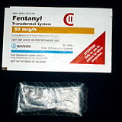
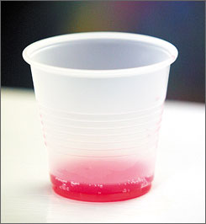
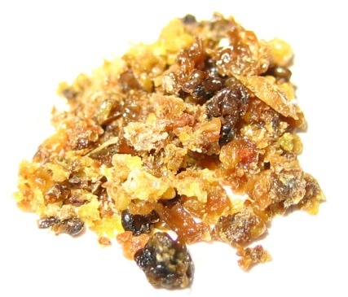
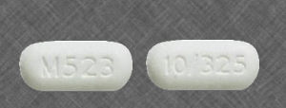
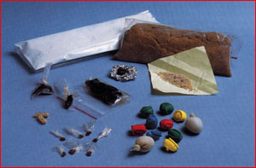
Prescription Drugs
Heroin
Codeine
Demerol
Morphine
Darvocet
Fentanyl
Dilaudid
Methadone
Opium
Hydrocodone
Oxycodone
Levorphanol
Vicodin
OxyContin
Tylenol 3
Tylox
Percocet
Percodan
Boston Public
Health
Commission
5

Slide 6
From Prescription Opioids to Heroin
Gateway Hypothesis
Approximately 3 out of 4 new heroin users report having abused prescription opioids in the past
Easier access to heroin than prescription opioids
Heroin does not require a prescription
Street price for heroin may be more affordable than prescription opioids
The concern with heroin
Higher risk of overdosing
Variable concentration with harmful impurities
Transmission of diseases through injection & needle sharing

Slide 7
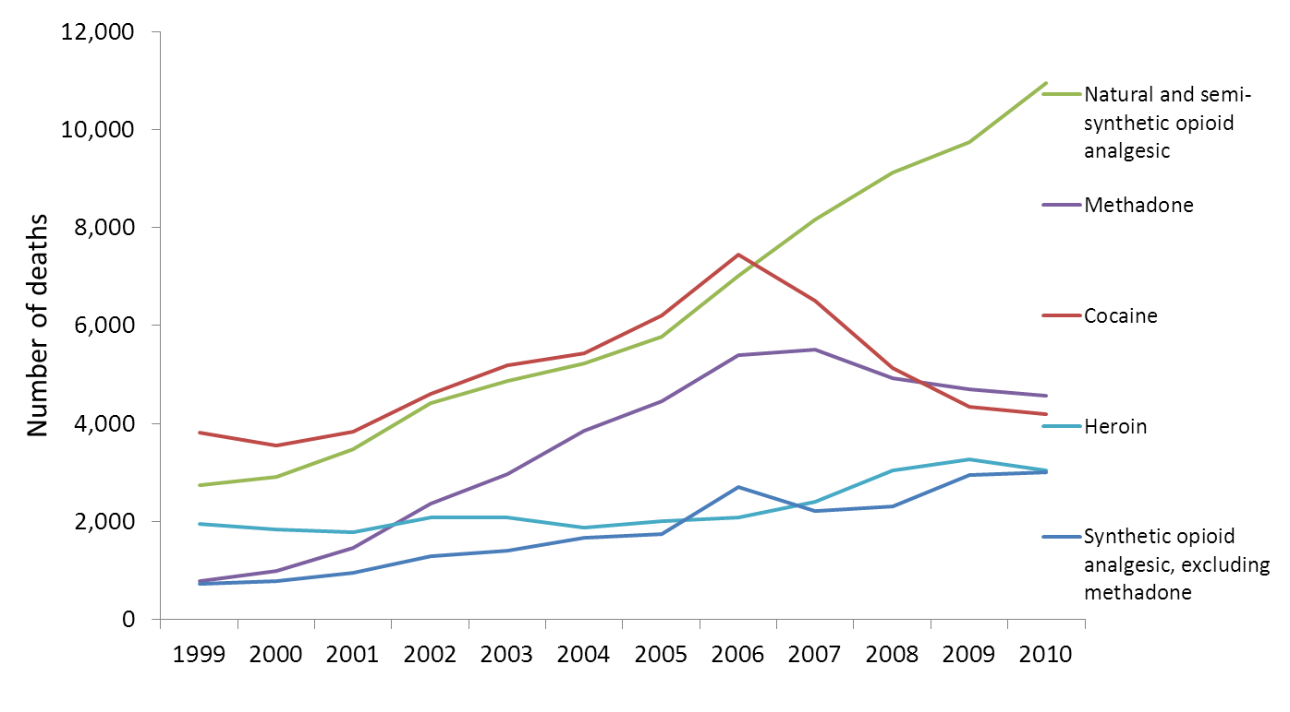
Number of drug poisoning deaths involving opioid analgesics by opioid analgesic category, heroin and cocaine: United States, 1999--2010
NOTES: Opioid analgesic categories are not mutually exclusive. Deaths involving more than one opioid analgesic category shown in this figure are counted multiple times. Natural and semi-synthetic opioid analgesics include morphine, oxycodone and hydrocodone; and synthetic opioid analgesics include fentanyl.
SOURCE: CDC/NCHS, National Vital Statistics System; and Warner M, Chen LH, Makuc DM, Anderson RN, Miniño AM. Drug poisoning deaths in the United States, 1980–2008. NCHS data brief, no 81. Hyattsville, MD: National Center for Health Statistics. 2011. http://www.cdc.gov/nchs/data/databriefs/db81.htm

Slide 8
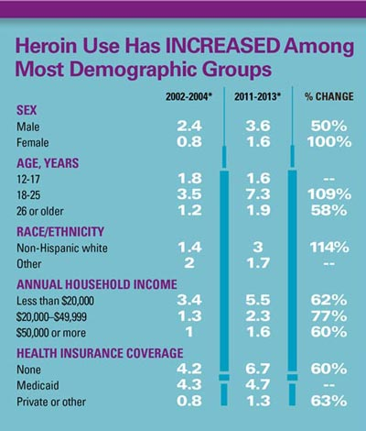
Heroin Abuse
Heroin is a semi-synthetic opioid with no accepted medical use in the US
Heroin is injected or snorted, which enters the body and brain very quickly to produce an extreme high that is highly addictive and dangerous
In 2015, approximately 0.3 million (0.1%) people 12 years or older were currently using heroin
"Heroin Overdose Data." Centers for Disease Control and Prevention. Centers for Disease Control and Prevention, 16 Dec. 2016. Web. 26 Jan. 2017.

Slide 9
Heroin Overdose Epidemiology
About 2% of heroin users die each year- many from heroin overdose
1990-98: 5,506 deaths in NYC
Average of 1-2/day in NYC
Up to 2/3 of heroin users experience at least one nonfatal overdose
2006: 979 OD deaths in NYC (70% due to opioids) = ~ 685 opioid deaths
Sporer BMJ 2003, Galea 2003, Coffin Acad Emerg Med 2007

Slide 10
An Ounce of Prevention…
Models of Prevention

Slide 11
Distribution of Consumption Model
Distribution of consumption approach, posits:
The proportion of heavy drinkers in a culture is positively related to the mean level of alcohol consumption
Heavier alcohol consumption increases the probability of alcohol problems
Alcohol consumption is a risk factor for use and abuse of other mind-altering substances.

Slide 12
Proscriptive Model
Proscriptive approach: focuses on prohibiting the availability of substances and emphasizes abstention from drug use
Takes a moral stance: if there is no use of the substance, then there can be no problem

Slide 13
Socio-ecological Model of Prevention
Dominant approach in the US
Posits that social norms directly influence substance use.

Slide 14
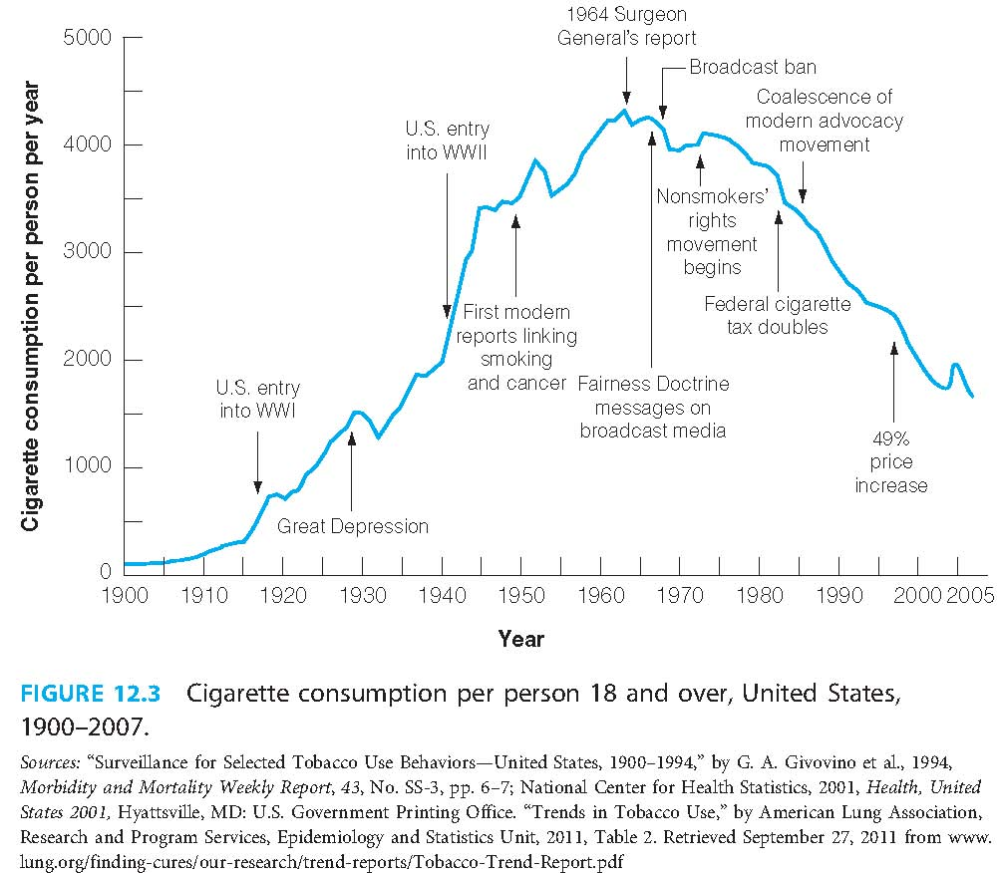
An Example of the Socio-ecological Model: Effecting Societal Behavior to Reduce Smoking Rates in the US

Slide 15
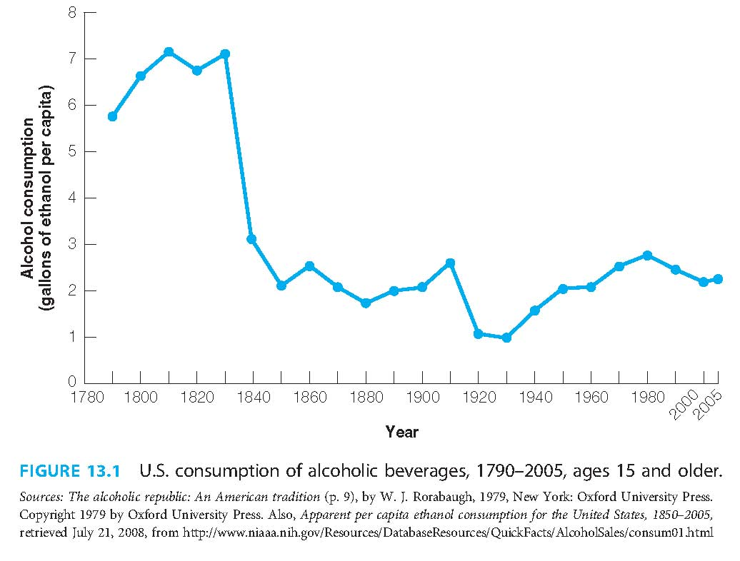
A Second Example of the Socio-ecological Model: The Long-term Impact of Prohibition

Slide 16
Four Levels of the Socio-ecological Model
Individual level: e.g., age, education, income, health, and psychosocial problems
Relationship level: e.g., individual’s closest social circle— family members, peers, teachers, and other close relationships — that contribute to his or her range of experiences and that may influence his or her behavior.
Community level: Includes the settings in which social relationships occur, e.g., schools, workplaces, and neighborhoods.
Social level: Includes the broad societal factors, i.e., social and cultural norms.

Slide 17
Individual Risk Factors for NMUPD
Demographic variables
Mental Health concerns
Acute and chronic pain
Physical health problems
Behavioral indicators
Protective factors

Slide 18
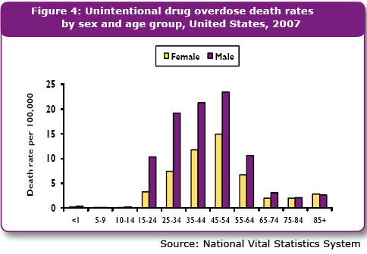
Individual Risk Factors – Demographic Factors
Religiosity
Having decreased religiosity
Spiritual beliefs influence decision-making
Age
Initiation of prescription drug misuse before age 13 (vs. after age 21)

Slide 19
Individual-Risk Factors – Mental Health
Current DX of Major Depressive Disorder
Current SI
Past 30-day anxiety
Having a prescription for tranquilizers
Excessive exposure to prescription opioids or benzodiazepines
Past year of PTSD
Past year of mood disorder
Past year of anxiety disorder
DX of ADHD
Having the perception that stimulant misuse is necessary to complete tasks

Slide 20
Individual Risk Factors- Pain and Perception of Pain
“Catastrophizing” current pain severity
Anticipatory anxiety about pain
High level of pain
Low pain tolerance
Chronic pain
Back pain
Having 12 or more physical health care visits in one year
Having one or more limitations on activities of
daily living
The link between pain, physical health problems, and opioid use is likely; opioids are often prescribed to lessen pain.

Slide 21
Opioid Pain Reliever (OPR) Death Rates, Sales, and Substance Abuse Treatment Admission Rates Increased in Parallel
National Vital Statistics System (99-09); Automated Reports Consolidated Orders System (99-10); Treatment Admissions Data Set (99-09)
Age-adjusted rates per 100,000 population for OPR deaths, crude rates per 10,000 population for OPR abuse treatment admissions, and crude rates per 10,000 population for kilograms of OPR sold.

Slide 22
The Best Predictor of Future Behavior is…..
History of other substance use or misuse
Risk takers
Polydrug users
Heightened physiological reactions to certain types of drugs (i.e., having a greater subjective euphoric reaction).
(McCabe & Teter, 2007; Sung, Richter, Vaughan, Johnson, & Thom, 2005).

Slide 23
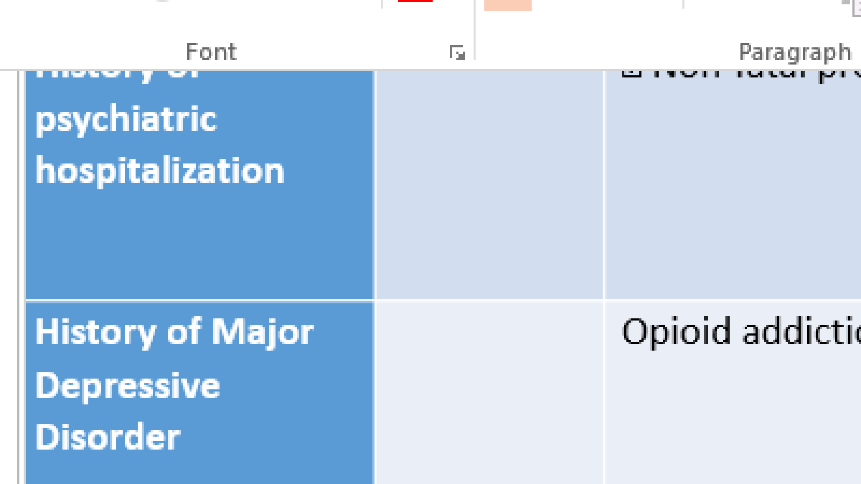
INDIVIDUAL-LEVEL MENTAL HEALTH RISK FACTORS
Risk Factor | Outcome(s) | Population | Citation
History of psychiatric hospitalization | Non-fatal prescription drug overdose | Individuals (mostly homeless) who misused prescription drugs at least three times in the past 90 days (age range = 16–25) | Silva, Schrager, Kecojevic, & Lankenau, 2013
History of Major Depressive Disorder | Opioid addiction | Individuals who received 4+ opioid prescriptions (age range = 18 or older) | Boscarino et al., 2010
Current DX of Antisocial Personality Disorder | Past-year prescription opioid misuse | Individuals who inject drugs (age range = 18–25; average age = 22.2) | Mackesy-Amiti, Donenberg, & Ouellet, 2015
Current DX of Major Depressive Disorder | Prescription opioid misuse | NSDUH respondents (age range = 12–17) | Ford & Rigg, 2015
 | Prescription opioid misuse | Individuals receiving chronic opioid therapy with no history of substance abuse (age range = 21–80) | Grattan, Sullivan, Saunders, Campbell, & Von Korff, 2012
 | Prescription opioid misuse | Outpatient clinic patients (average age = 72.8) | Park & Lavin, 2010
[National Survey on Drug Use and Health

Slide 24
INDIVIDUAL-LEVEL MENTAL HEALTH RISK FACTORS
Risk Factor | Outcome(s) | Population | Citation
Having a current depression diagnosis (cont.) | Risk for opioid misuse | Individuals with cancer receiving services from a pain center | Koyyalagunta et al., 2013
Having a current mental health disorder | Prescription opioid abuse | Veterans who were being prescribed 91-day or more supply of opioids, never had a cancer diagnosis, and have not had an opioid dependence diagnosis | Edlund, Steffick, Hudson, Harris, & Sullivan, 2007
Having a mental health disorder diagnosis | Opioid abuse Opioid dependence | Medicaid and private insurance network enrollees who were prescribed at least 90 days of opioids | Edlund et al., 2010
 | Opioid use disorder | Private insurance network enrollees with a cancer diagnosis | Edlund et al., 2014
 | Prescription opioid misuse | Medicaid and private insurance network enrollees who used opioids for at least 90 days | Sullivan et al., 2010
Having ever been diagnosed with posttraumatic stress disorder | Past-year prescription opioid misuse Past-year prescription opioid abuse Past-year prescription opioid dependence | Men who inject drugs (age range = 18–25; average age = 22.2) | Mackesy-Amiti, Donenberg, & Ouellet, 2015
Having high attentional impulsivity | Risk for prescription opioid misuse | Individuals receiving opioid therapy for chronic low-back pain (average age = 47.5) | Marino et al., 2013

Slide 25
INDIVIDUAL-LEVEL MENTAL HEALTH RISK FACTORS
Risk Factor | Outcome(s) | Population |  | Citation
Having suicidal ideation | Prescription drug misuse | Homeless youth (average age = 21.5) |  | Rhoades, Winetrobe, & Rice, 2014
Past 30-day anxiety | Risk for opioid misuse | Individuals with cancer receiving services from a pain center |  | Koyyalagunta et al., 2013
Past-year anxiety diagnosis | Prescription opioid misuse | NSDUH respondents (age range = 18– 25) |  | Mowbray & Quinn, 2015
Past-year posttraumatic stress disorder diagnosis | Past-year prescription opioid abuse Past-year prescription opioid dependence | Men who inject drugs (age range = 18–25; average age = 22.2) |  | Mackesy-Amiti, Donenberg, & Ouellet, 2015
Past-year substance-induced major depression diagnosis | Past-year prescription opioid misuse | Individuals who inject drugs (age range = 18–25; average age = 22.2) |  | Mackesy-Amiti, Donenberg, & Ouellet, 2015
Past-year mood disorders | Prescription opioid abuse Doctor shopping | Individuals in pharmaceutical coverage claims databases who were prescribed either tapentadol Immediate Release (IR) or oxycodone IR |  | Cepeda, Fife, Kihm, Mastrogiovanni, & Yuan, 2014
Experiencing Pain
“Catastrophizing” current pain severity | Risk for prescription opioid misuse | Veterans who have a current or previous substance use disorder and received an opioid prescription in the last 90 days (average age = 55 |  | Morasco, Turk, Donovan, & Dobscha, 2013

Slide 26
Protective Factors at the Individual Level
Commitment to doing well and finishing school
Get that High School Diploma!!!
Perceptions about prescription drug misuse
Assess!!!!
Social Development Model
Values and Norms
Social Norms Approach

Slide 27
Relationship Level Factors
Access to stimulants in the home (Kecojevic et al., 2012 )
Modeling
Greater parental favorable attitudes towards substance abuse
Greater peer favorable attitude towards substance abuse
Lifetime witnessing a family member overdose (Silva, Schrager, Kecojevic, & Lankenau, 2013)

Slide 28
Relationship-Level Protective Factors
Modeling
Successful attachment

Slide 29
Community Level Factors: Education and Mass Media Efforts
Most common substance abuse prevention interventions
Drug and alcohol education
Now requires by most states in school curricula.
Generally increase knowledge; does not effect behavior
Worksite programs: prevention
Goal of identifying drug abusers and intervening when drug problems interfere with job performance
Concentrate more on secondary than on primary prevention
Affect-oriented programs
Involve decision making, values clarification - exploration of one’s own needs and beliefs regarding drugs
Help clarify personal views on drug behavior

Slide 30
Prevention Programs Data Outcomes Are Largely Disappointing
Ineffective Programs rely on
scare tactics (DARE)
Moral training
Factual information about risks
More promising programs provide
Life skills training (resist social pressure)

Slide 31
So…..What CAN We Do?

Slide 32
Practical Tips for Prevention
Learn the signs!!!!
Collaborate with your patient’s health care team!
The recommended action for a “no recent opioid use” result is to deliver a prevention message to continue abstinence.
Give positive reinforcement for abstinence.
Personalize the prevention message as much as possible.

Slide 33
Learn the Signs
Noticeable excitement or euphoria
Unusual sedation or confusion
“Doctor shopping”
Sudden financial problems
Physical withdrawal symptoms
Talk to family members and loved ones about monitoring use of prescription medications

Slide 34
Tobacco, Alcohol, Prescription Medication, and other Substance Use Tool (TAPS)
Combines screening and brief assessment for commonly used substances, eliminating the need for multiple screening and lengthy assessment tools
Provides a two stage brief assessment adapted from the NIDA quick screen and brief assessment
May be either self-administered directly by the patient or as an interview by a health professional
Uses an electronic format
Uses a screening component to ask about frequency of substance use in the past year
Facilitates a brief assessment of past 90-day problem use to the patient

Slide 35
Assess for Vulnerability Factors for Overdosing
After periods of abstinence (after treatment stay, hospitalization, incarceration)
New city/residential location
New dealer
Post incarceration
New route of administration

Slide 36
Risk Factors for Overdosing
Misjudging body tolerance (relapse after period of abstinence)
Using an opioid with other depressants such as alcohol or benzodiazepines increases the risk
Variation of substance
Using drugs alone
Mixing drugs and alcohol
Poor physical health
Cocaine/methamphetamine are stimulants but can contribute to overdose risk when used in combination with opioids

Slide 37
The Power of Narcotics Anonymous
1. We admitted that we were powerless over our addiction, that our lives had become unmanageable.
2. We came to believe that a Power greater than ourselves could restore us to sanity.
3. We made a decision to turn our will and our lives over to the care of God as we understood Him.
4. We made a searching and fearless moral inventory of ourselves.
5. We admitted to God, to ourselves, and to another human being the exact nature of our wrongs.
6. We were entirely ready to have God remove all these defects of character.
7. We humbly asked Him to remove our shortcomings.
8. We made a list of all persons we had harmed, and became willing to make amends to them all.
9. We made direct amends to such people wherever possible, except when to do so would injure them or others.
10. We continued to take personal inventory and when we were wrong promptly admitted it.
11. We sought through prayer and meditation to improve our conscious contact with God as we understood Him, praying only for knowledge of His will for us and the power to carry that out.
12. Having had a spiritual awakening as a result of these steps, we tried to carry this message to addicts, and to practice these principles in all our affairs.
Any addict can stop using and lose to the desire to use.

