Slide 1
A Year in Review
2018-2019

Slide 3
Highlights of the Year
Conferences
New Graduate Events
Mentorship Program
Journals
Chapter Events
Vaccine Education
Membership
Organizational Compliance

Slide 4
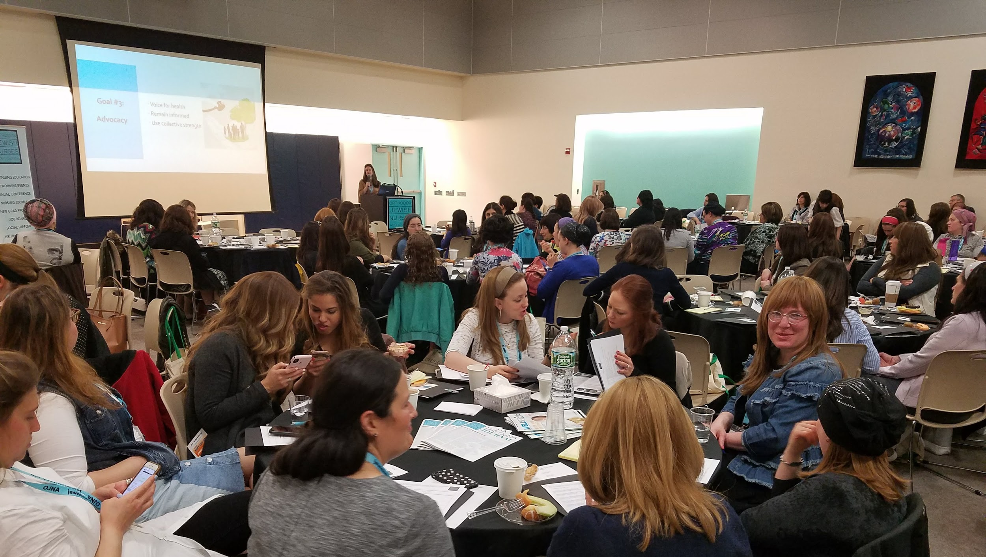
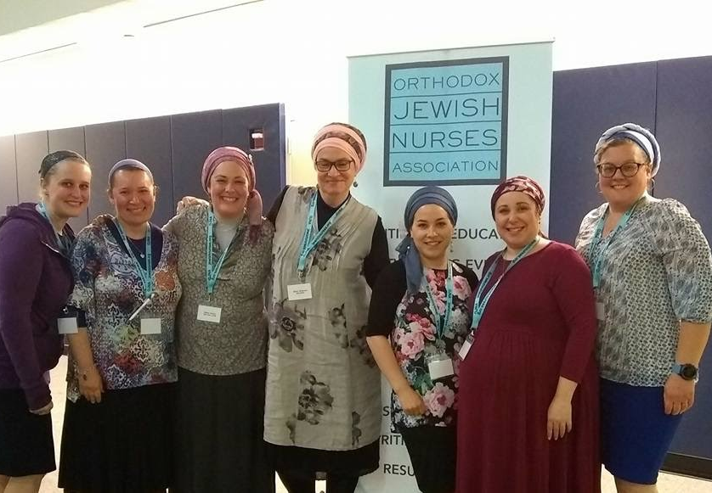
2018: Annual Nursing Conference

Slide 5
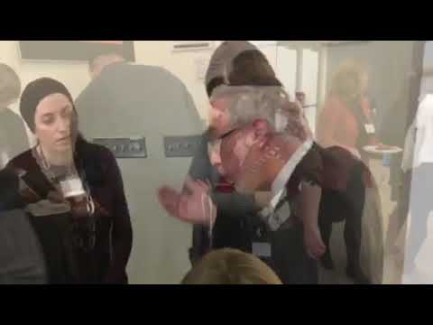
2019: APRN Conference

Slide 6
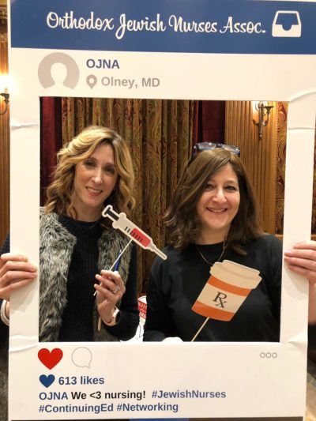
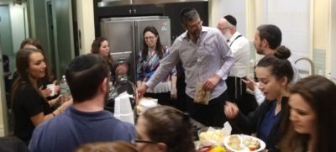
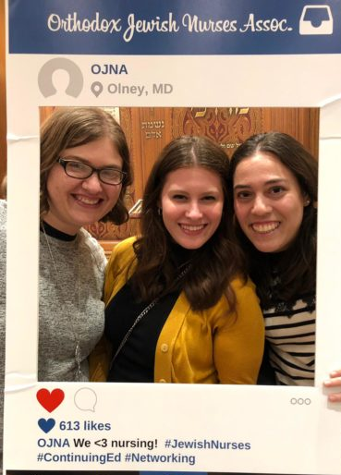
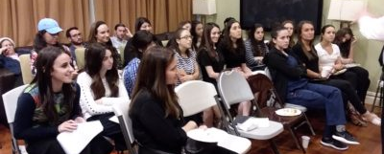
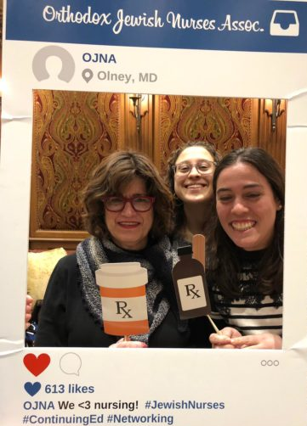
New Graduate Events

Slide 7
Mentorship Program
30 new grads paired with mentors
27 resumes reviewed

Slide 8
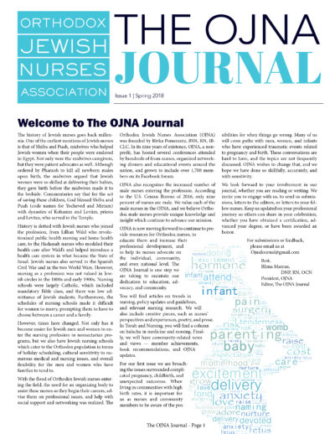
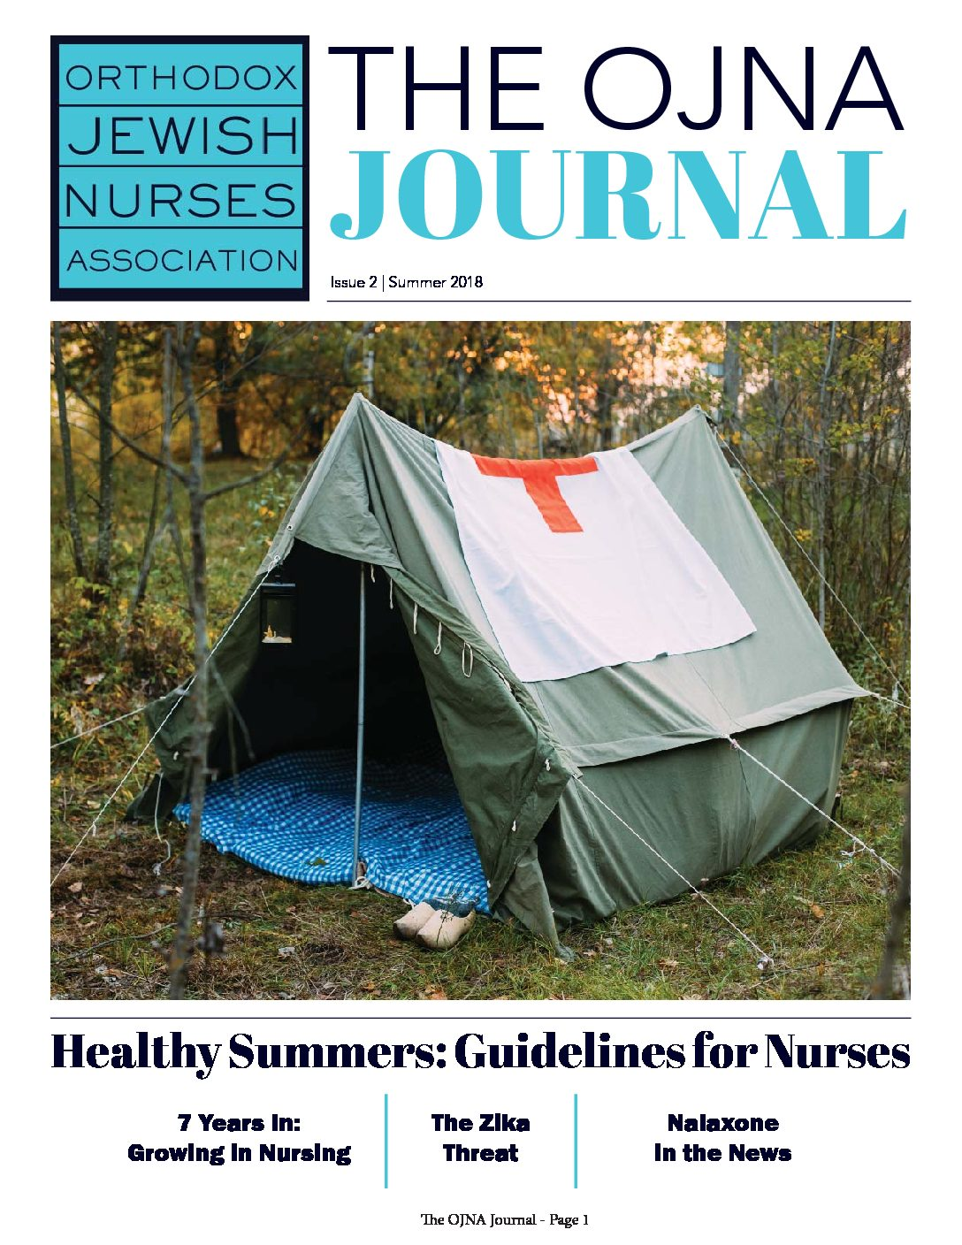
The OJNA Journal

Slide 9
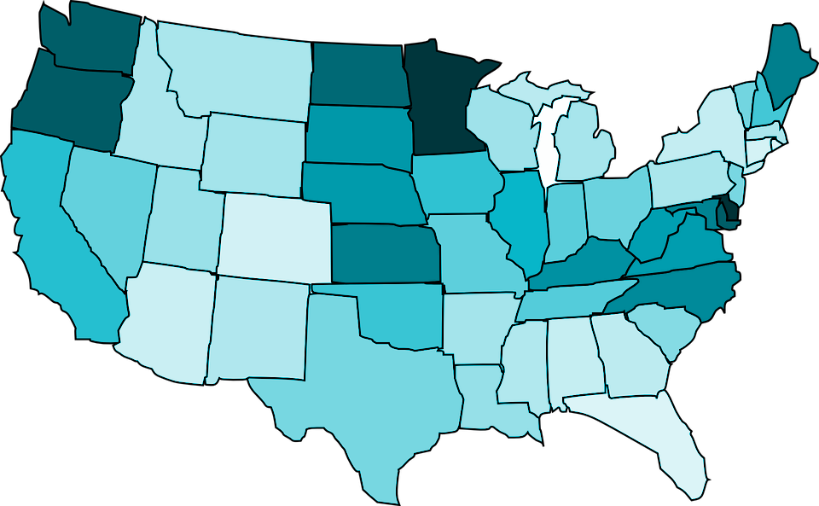
Chapter Events
Miami, FL
Ft Lauderdale, FL
Cleveland, OH
Detroit, MI
Silver Spring, MD
Pittsburgh, PA
Chicago, IL
California - event soon!

Slide 11
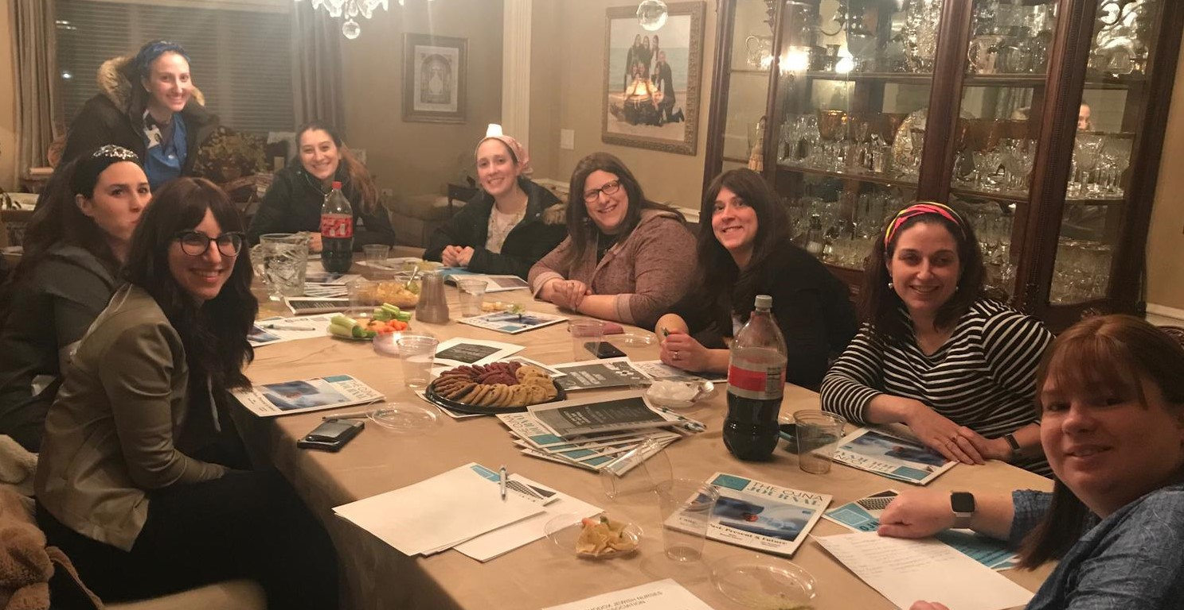
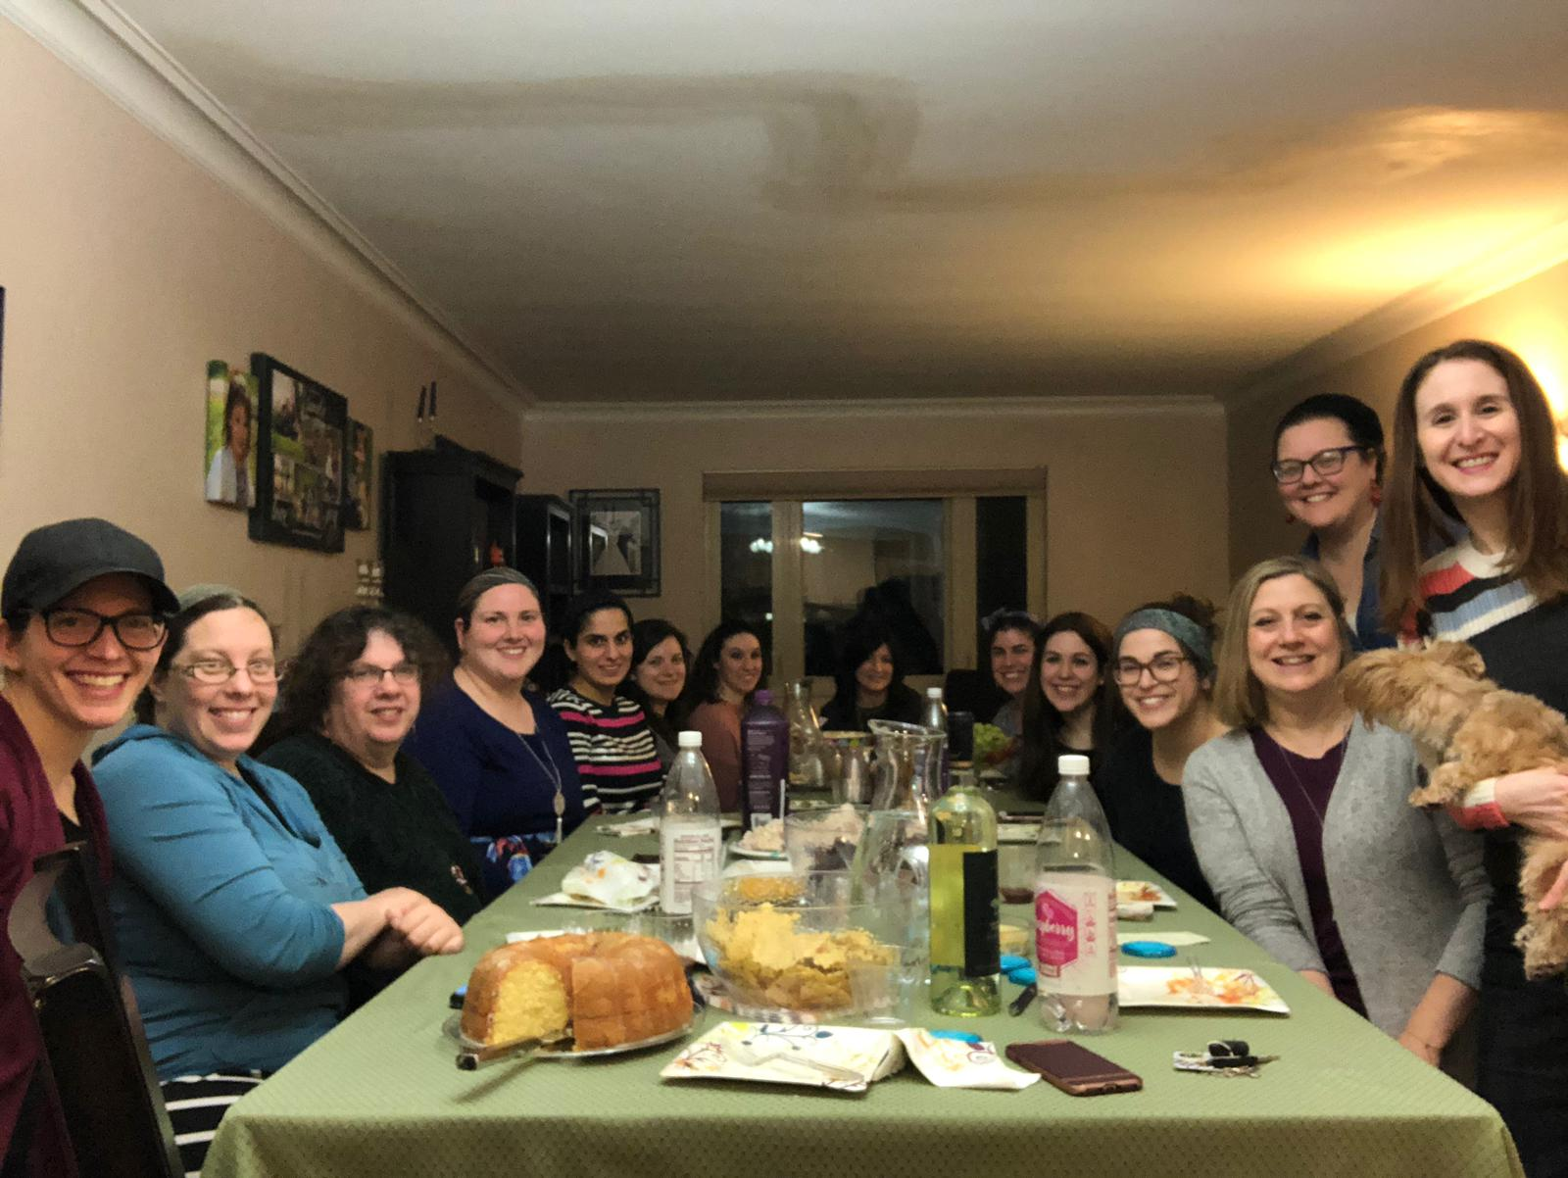

Slide 12
Vaccine Education
Informational powerpoint for nursing education
Intimate in-home education sessions in select communities
Initial development of the PIE pamphlet
Many requests for interviews from news reporters
The vaccine task force now continues its important work under the newly developed EMES Initiative led by former OJNA president Blima Marcus

Slide 13
Membership:
Jewishnurses.org
Tremendous growth over the past year!
From 0 to 231 paying members
Special website content for members only
230+ jobs posted on our job board
Many comments and thank yous sent in via our website

Slide 14
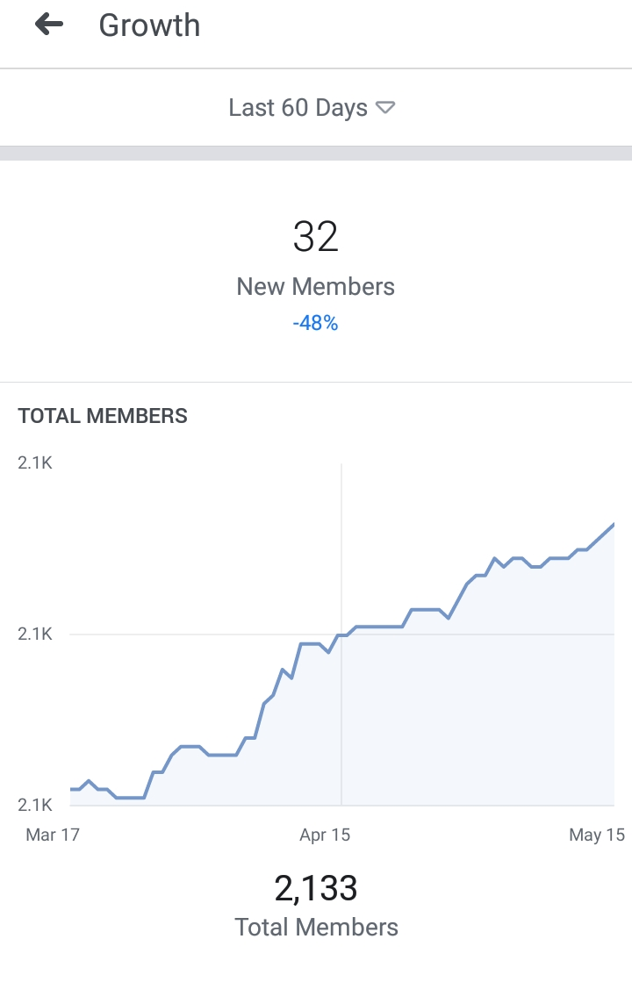
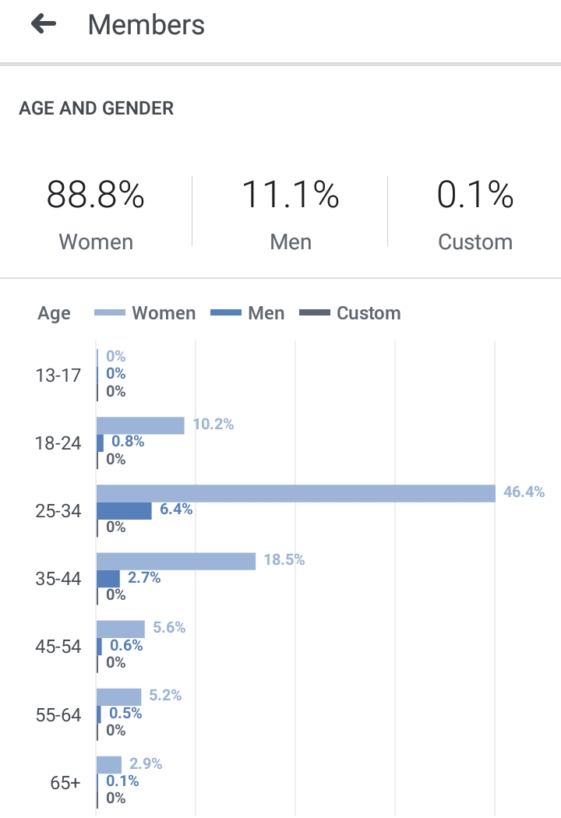
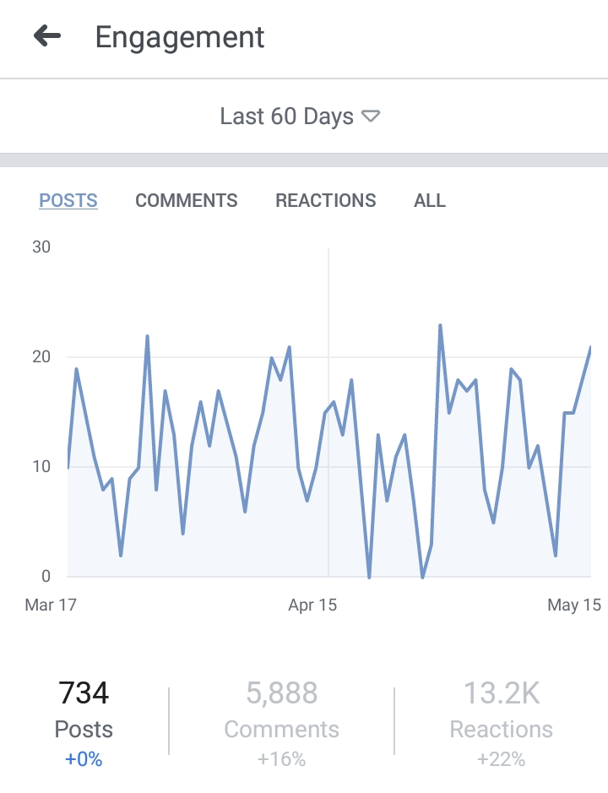
Facebook Forum

Slide 15
Organizational Compliance
In progress...

Slide 16
Thank you!
Board members
Conference committee
Journal committee
New grad committee
Resume reviewers
Website designer
Graphic designer
Accountant
Attorneys
Members

